Slide 1
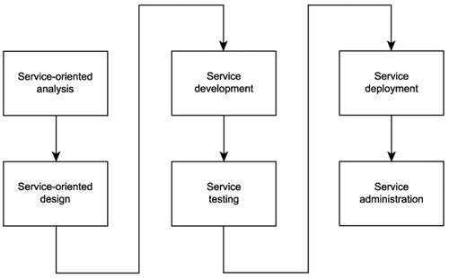
Service development
Actual construction phase
The choice of programming language
The choice of development environment

Slide 2

Open Question
Points: 10
What are some examples of service development technologies?
Open Question is only supported on Version 2.0 or newer.
Answer

Slide 3
Summary

Slide 4
Module 6 Summary
SOA lifecycle and SOA delivery strategies
How to conduct service-oriented analysis
How to design services

